Slide 1

RAJALAKSHMI ENGINEERING COLLEGE
DEPARTMENT OF COMPUTER SCIENCE
IOT BASED SMART WATER HEATER
RAM PRAKASH L-210701208
RAVEENA SRI R-210701210

Slide 2
INTRODUCTION
The IoT-Based Smart Water Heater project tackles the inefficiencies and inconvenience of traditional water heaters by utilizing IoT technology. By incorporating smart sensors and a connected mobile app, the system provides real-time monitoring, remote control, and optimized heating schedules based on user habits and environmental conditions. This innovative solution boosts energy efficiency, lowers operational costs, and enhances user convenience, delivering a smarter and more sustainable approach to water heating management

Slide 3
PURPOSE OF THE PROJECT
The purpose of the system is to improve the efficiency, convenience, and sustainability of water heating in residential settings. By integrating advanced IoT technology, the system aims to provide users with real-time monitoring and remote control capabilities via a mobile app. It optimizes heating schedules based on user behavior and environmental conditions, enhancing energy efficiency and reducing operational costs. Additionally, the system incorporates safety features, such as temperature monitoring and motion detection, to prevent accidents and ensure user safety. Overall, the purpose is to deliver a smarter, more efficient, and user-friendly water heating solution.

Slide 4
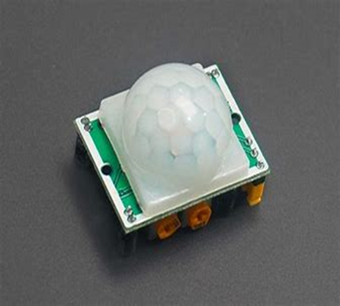
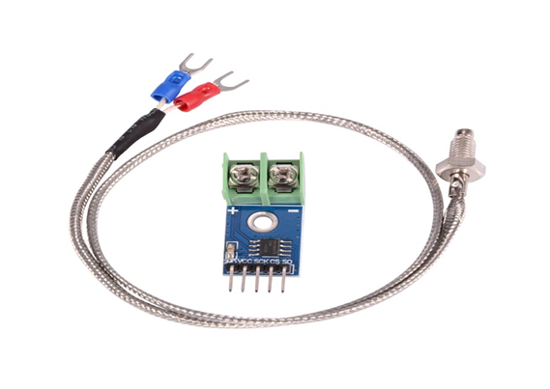
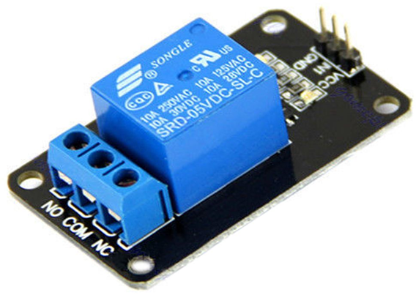
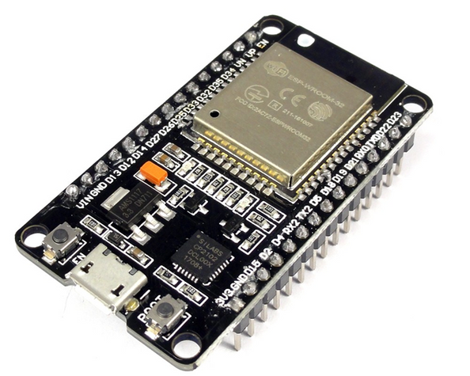
COMPONENTS
Jumper cables
BreadBoard
BLYNK IOT

Slide 5
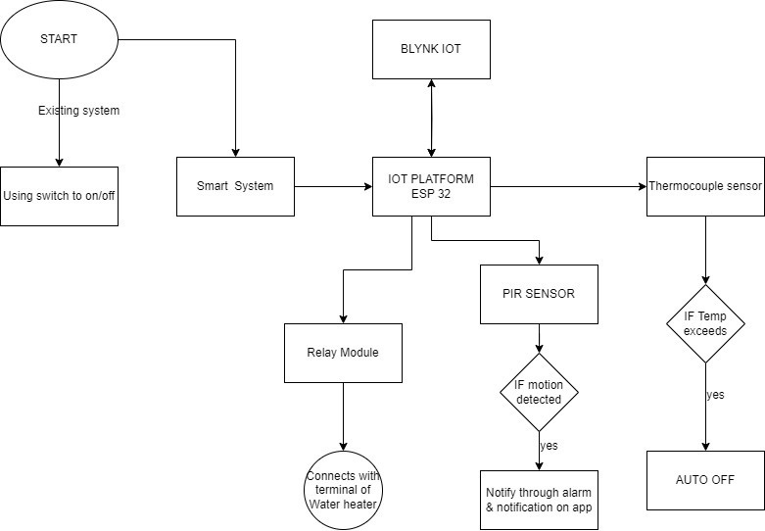
ARCHITECTURE DIAGRAM

Slide 6
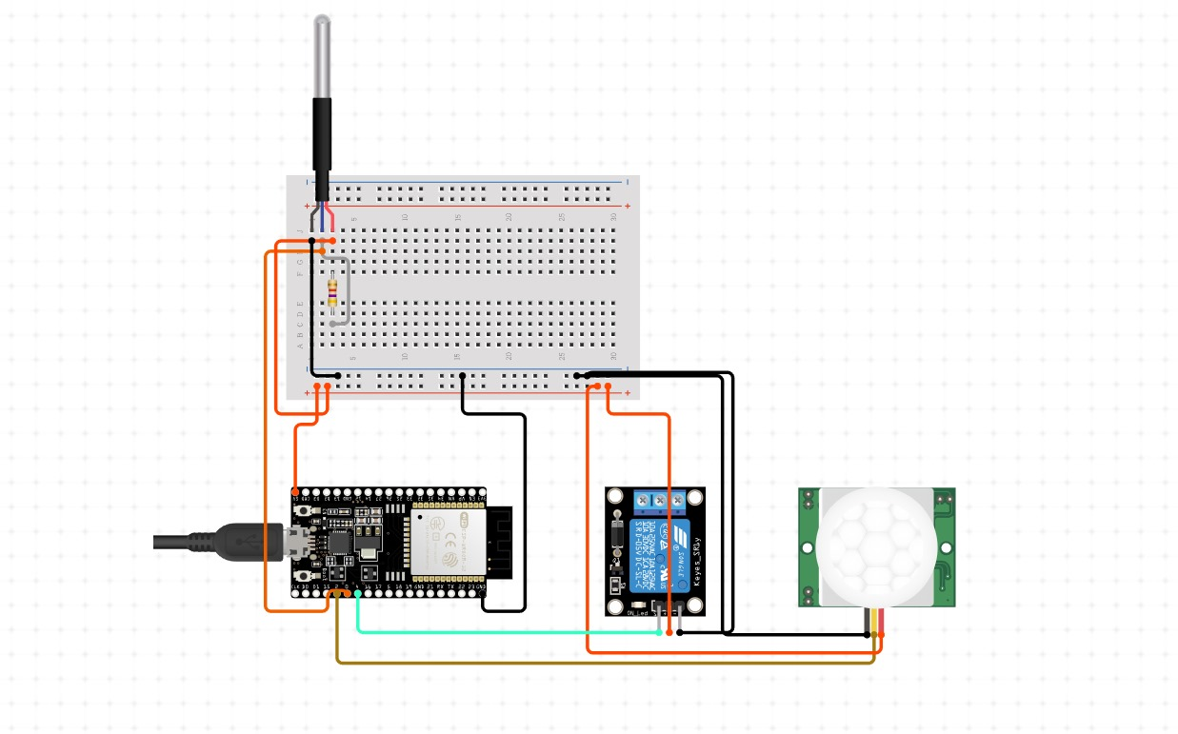
CIRCUIT DIAGRAM

Slide 7

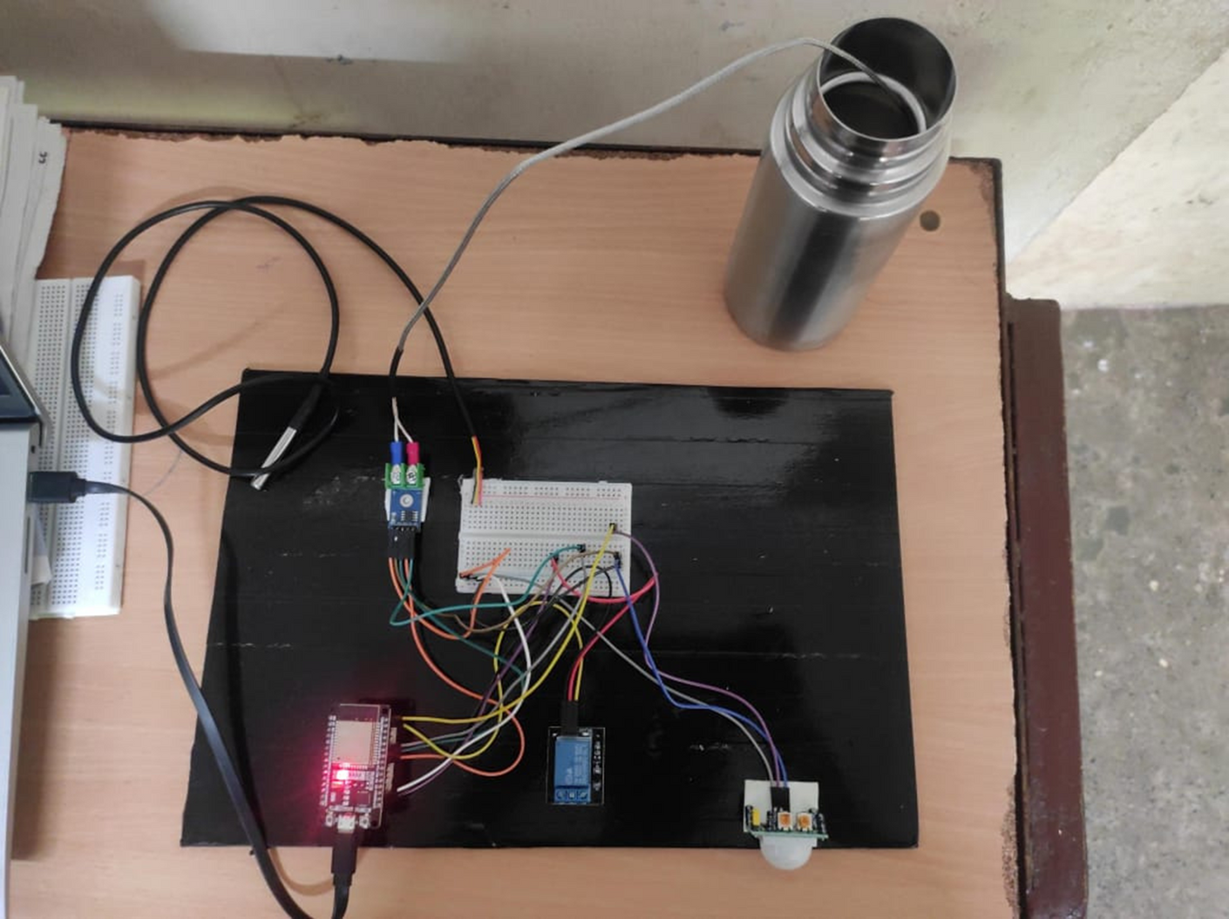
WORKING MODEL

Slide 8
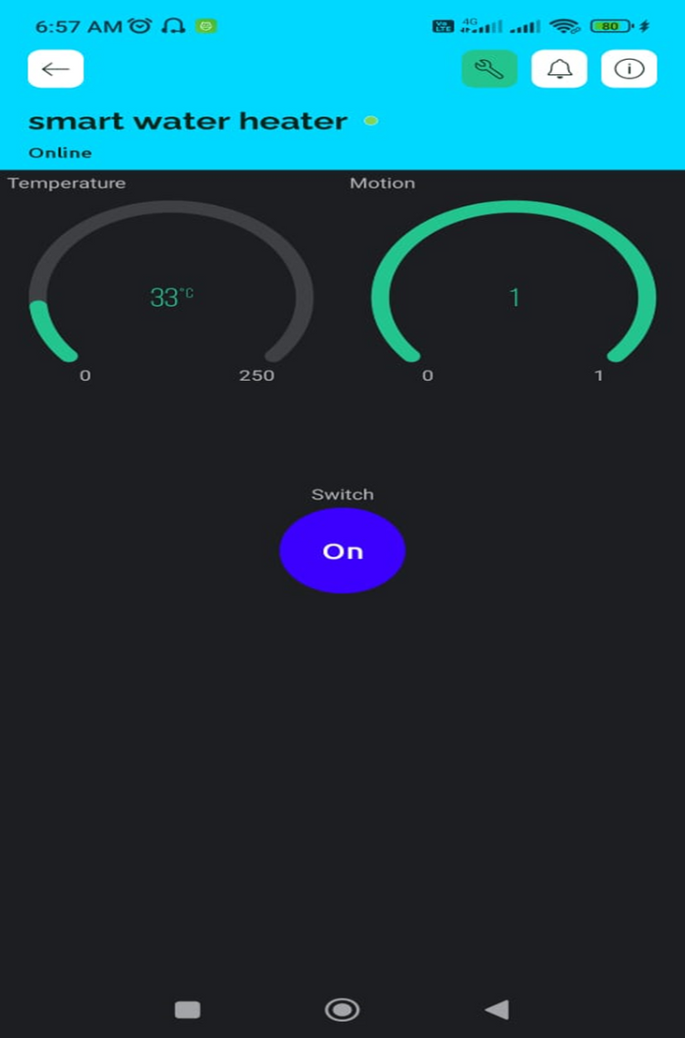
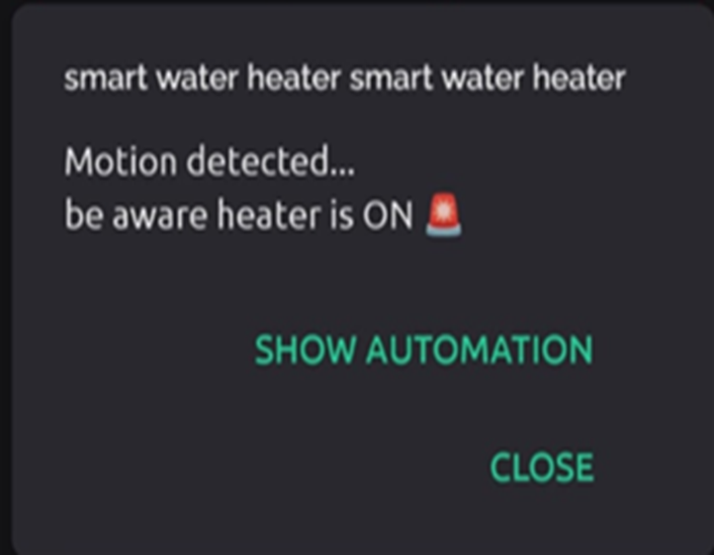
OUTPUT

Slide 9
COMPARISONS
EXISTING SYSTEM | PROPOSED SYSTEM
Traditional water heaters have manual controls | Integrating smart sensors to monitor water temperature, humidity, and potential leaks
lacks remote accessibility or smart features | A mobile app or web interface enables users to remotely control temperature settings, set heating schedules, and receive real-time alerts
Users typically manually adjust temperature settings without real-time monitoring or automation | Integrate safety features such as leak detection and automatic shutdown

Slide 10

CONCLUSION
It provides advantages in terms of convenience, energy efficiency, and safety.
Users can remotely control and monitor their
water heaters through smartphone apps or
web interfaces

Slide 11

FUTURE ENHANCEMENT
Integrating advanced connectivity standards
such as 5G or LPWAN would ensure faster
and more reliable communication
Predictive maintenance algorithms could
minimizing breakdowns

Slide 12
THANK YOU

